Slide 1


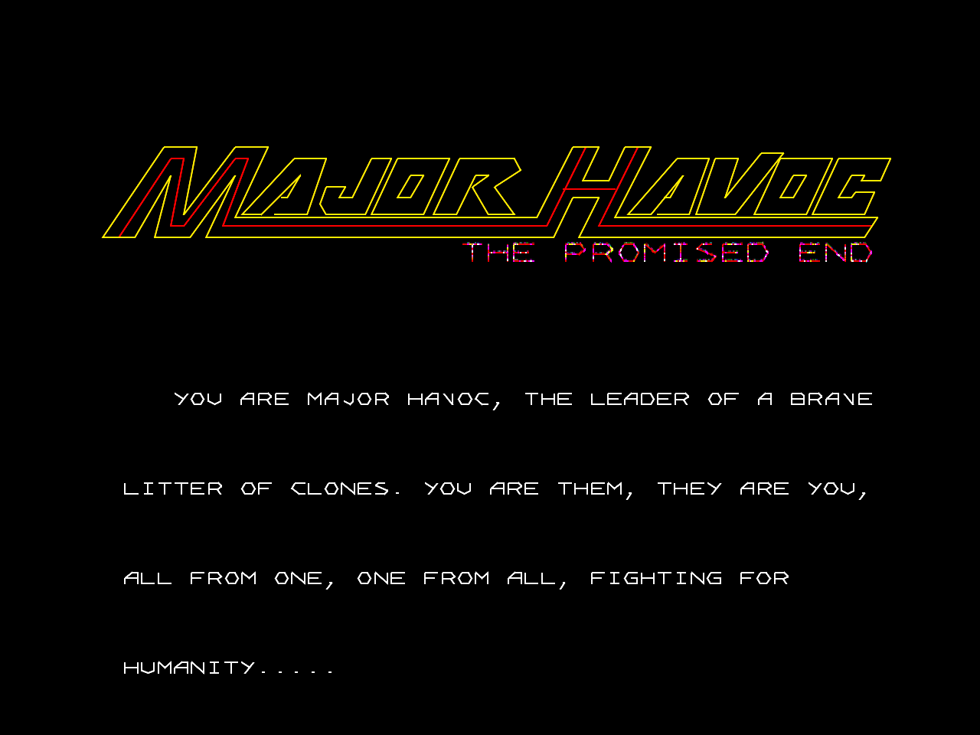

It’s DONE! *
Team Havoc

Slide 2





Team Havoc
Owen Rubin
Jess Askey
Bryan Roth
Jerky
Inspirer of All
Coder and Tangent Specialist
Level Editor, Advisor, Play Testing
New Level Designs

Slide 3
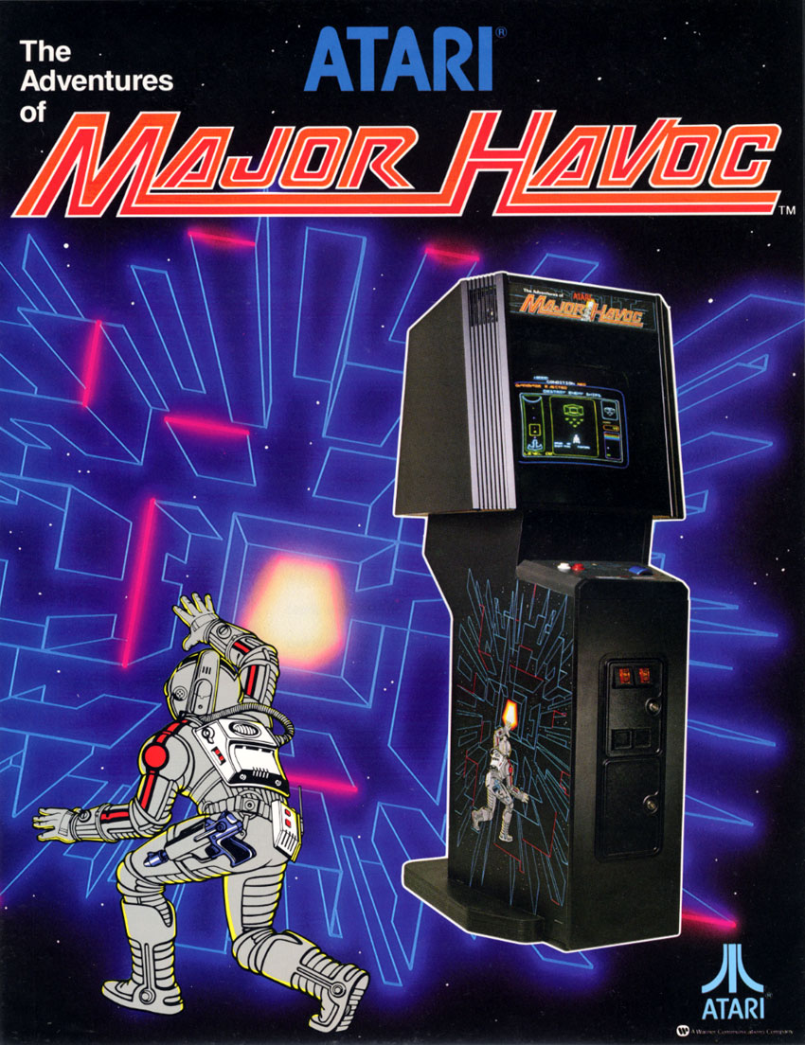
Often Imitated, Never Duplicated
Created by Owen Rubin
Released by Atari in 1983

Slide 4
CAX Presentations
CAX 2018 – Initial announcement – Hopes and Dreams v0.51 released
CAX 2019 – Updated Project Status, early BETA ROM release v0.77 released
2020/2021 – COVID HELL and distractions
CAX 2022 – v1.0 Release – YAY!

Slide 5
Throwback… Why?
Keep Going The Homeworld Is Near
Started Coming together in 2016 to start creating ‘The Promised End’
Name suggested by Luke Dyson
Is this project a little out of control? Maybe, but it is fun!
Hope to make this Open Source
Copyrights
Profits – NONE – Game is FREE

Slide 6


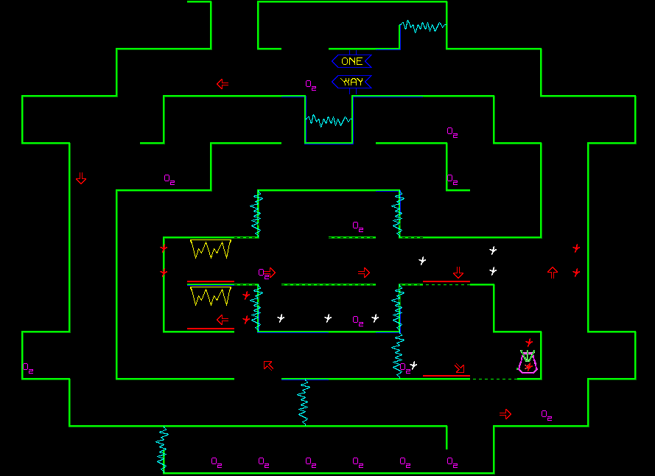
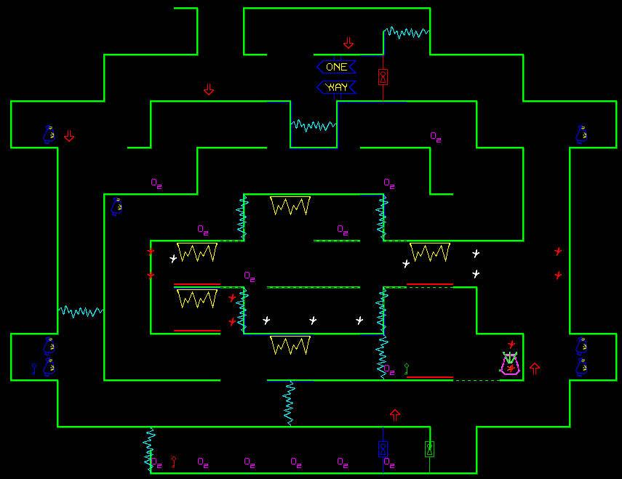
Two Editions!
The Promised End - All features but Mazes are more approachable to the average player
Tournament Edition - All features but Mazes are pushed to the limit with more challenging layouts & enemies – Jerky’s *Dreamy* Levels

Slide 7
Gameplay Features
8 NEW Levels + 4 secret levels
3 additional warps AND Game specific warps
Homeworld Space Station – with Mega Reactor
3D Star Castle Battle – mimics Owen’s original Star Castle that only existing briefly in early development and was deemed ‘to long’ for arcade play.
Speech Added
Two Options for speech
TMS-5220 LPC Speech – Classic early 80’s speech tech found in games of the early/mid 1980’s
MSM-6295 ADPCM Speech – Used in 1990’s games with improved speech quality (requires add-on card)

Slide 8
Gameplay Features (cont)
Maxoid Robot
Updated Attract Mode – Original Team and Promised End team
Homeworld Animation sequence and ending trailer
Battlezone Mountains - Set up for the Atari Cinematic Universe (kidding))
Multilingual
English/French/German versions of ROM images
Bonus gameplay after Homeworld
Many easter eggs

Slide 9
Features Self Test
Alpha Test
More detailed ROM checksums and version info
Gamma Test
More detailed component tests
All Sounds/Speech can be played here
Game Settings
Set in realtime (like Gauntlet etc) rather than needing to flip DIP switches
Roller Multiplier for Tempest Spinners
Cocktail Mode Supported – Scott Swazey FPGA Emulation
Warp Codes – Classic vs Randomized
Game Statistics

Slide 10
BUGS!
Still have about a dozen bugs to fix in the coming weeks
Updates will be posted as additional ROM versions v1.01, v1.02, v1.03 etc
Keep an eye on the GitHub ROM page

Slide 11
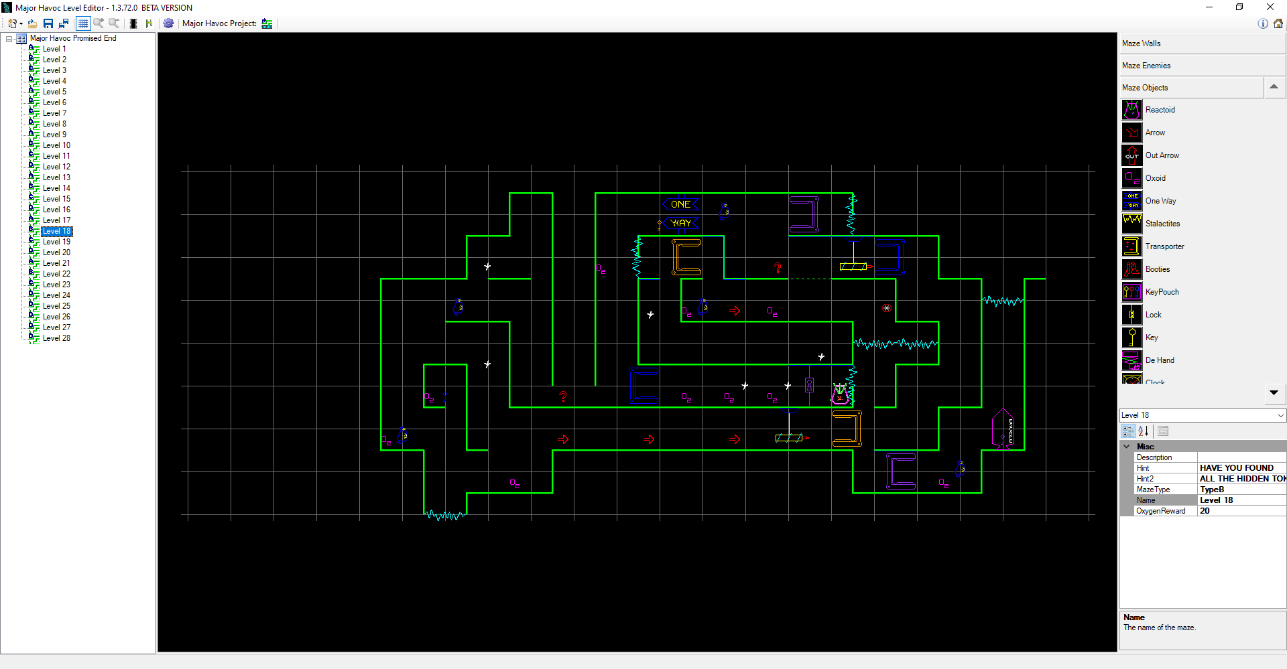
Level Editor
Allows editing of individual levels and play test in MAME on a PC
Allows creation of all 28 mazes in a ‘maze collection’
Mazes and collections can be saved to files and/or shared
Maze Collections can be ‘pushed’ into Major Havoc – The Promised End ROMs to be played in either MAME or on physical hardware.

Slide 12
Resources and More Information
Homepage – https://mhedit.askey.org
Game Overview
Features list
Level Editor Information
Game Marquee Translite Info
Speech Daughtercard Upgrade
GitHub Page - https://github.com/jessaskey/mhavocpe
PCB Conversion Info – Original PCB must be slightly modified to play this game
ROM Images – Playable in MAME OR on Modified Hardware
Source code and compilation tools

Slide 13

Special Thanks!!!
CAX Team – Always appreciative to be at this awesome show.
Jon Koolpe – Being a willing tester and early modder on his hardware. Always taking care of us!
Scott Swazey – Supporting project on his FPGA and giving excellent advice and help on issues and challenges
L.D. Murphy – Following along the project and writing up excellent article in Retrogamer #233 (now available online and hard copy!)
Jerome Vince and Thomas Sontowski – French and German translations
Al Kossow – RGVAC expert and archivist extraordinaire

